Slide 1
Implementation of Borders

Slide 2
CSS Border Style
dotted - Defines a dotted border
dashed - Defines a dashed border
solid - Defines a solid border
double - Defines a double border
groove - Defines a 3D grooved border. The effect depends on the border-color value
ridge - Defines a 3D ridged border. The effect depends on the border-color value

Slide 3
inset - Defines a 3D inset border. The effect depends on the border-color value
outset - Defines a 3D outset border. The effect depends on the border-color value
none - Defines no border
hidden - Defines a hidden border

Slide 4
Examples
p.dotted {border-style: dotted;} p.dashed {border-style: dashed;} p.solid {border-style: solid;} p.double {border-style: double;} p.groove {border-style: groove;} p.ridge {border-style: ridge;}

Slide 5
p.inset {border-style: inset;} p.outset {border-style: outset;} p.none {border-style: none;} p.hidden {border-style: hidden;} p.mix {border-style: dotted dashed solid double;}

Slide 6
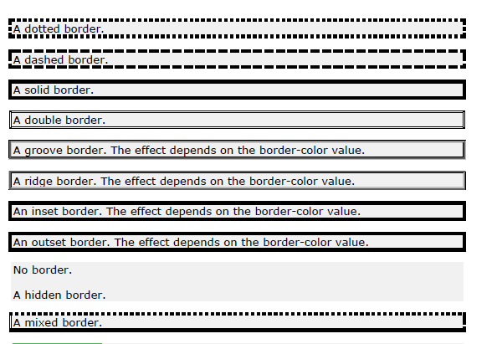

Slide 7
<html>
<head>
<style>
p.dotted {border-style: dotted;}
p.dashed {border-style: dashed;}
p.solid {border-style: solid;}
p.double {border-style: double;}
p.groove {border-style: groove;}
p.ridge {border-style: ridge;}

Slide 8
p.inset {border-style: inset;}
p.outset {border-style: outset;}
p.none {border-style: none;}
p.hidden {border-style: hidden;}
p.mix {border-style: dotted dashed solid double;}
</style>
</head>
<body>
<h2>The border-style Property</h2>
<p>This property specifies what kind of border to display:</p>

Slide 9
<p class="dotted">A dotted border.</p>
<p class="dashed">A dashed border.</p>
<p class="solid">A solid border.</p>
<p class="double">A double border.</p>
<p class="groove">A groove border.</p>
<p class="ridge">A ridge border.</p>
<p class="inset">An inset border.</p>
<p class="outset">An outset border.</p>
<p class="none">No border.</p>
<p class="hidden">A hidden border.</p>
<p class="mix">A mixed border.</p>
</body>
</html>

Slide 10
CSS Border Width
The border-width property specifies the width of the four borders.
The width can be set as a specific size (in px, pt, cm, em, etc) or by using one of the three pre-defined values: thin, medium, or thick:

Slide 11
Demonstration of the different border widths:
p.one { border-style: solid; border-width: 5px; } p.two { border-style: solid; border-width: medium; }

Slide 12
p.three { border-style: dotted; border-width: 2px; } p.four { border-style: dotted; border-width: thick; }

Slide 13
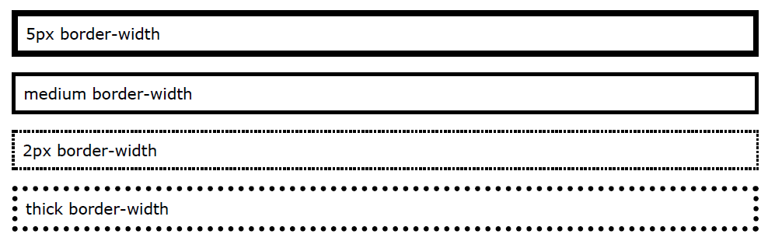

Slide 14
Specific Side Widths
p.one { border-style: solid; border-width: 5px 20px; /* 5px top and bottom, 20px on the sides */ } p.two { border-style: solid; border-width: 20px 5px; /* 20px top and bottom, 5px on the sides */ } p.three { border-style: solid; border-width: 25px 10px 4px 35px; /* 25px top, 10px right, 4px bottom and 35px left }

Slide 15
<html>
<head>
<style>
p.one {
border-style: solid;
border-width: 5px 20px; /* 5px top and bottom, 20px on the sides */
}
p.two {
border-style: solid;
border-width: 20px 5px; /* 20px top and bottom, 5px on the sides */
}
p.three {
border-style: solid;
border-width: 25px 10px 4px 35px; /* 25px top, 10px right, 4px bottom and 35px left

Slide 16
}
</style>
</head>
<body>
<h2>The border-width Property</h2>
<p>The border-width property can have from one to four values (for the top border, right border, bottom border, and the left border):</p>
<p class="one">Some text.</p>
<p class="two">Some text.</p>
<p class="three">Some text.</p>
</body>
</html>

Slide 17
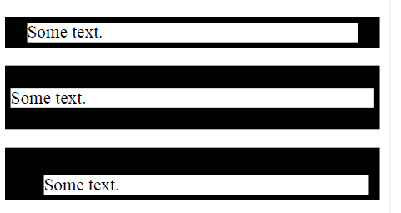

Slide 18
CSS Border Color
The color can be set by:
name - specify a color name, like "red"
HEX - specify a HEX value, like "#ff0000"
RGB - specify a RGB value, like "rgb(255,0,0)"
HSL - specify a HSL value, like "hsl(0, 100%, 50%)"
transparent

Slide 19
p.one { border-style: solid; border-color: red; } p.two { border-style: solid; border-color: green; } p.three { border-style: dotted; border-color: blue; }

Slide 20
<html>
<head>
<style>
p.one {
border-style: solid;
border-color: red;
}
p.two {
border-style: solid;
border-color: green;
}
p.three {
border-style: dotted;
border-color: blue;
}

Slide 21
</style>
</head>
<body>
<h2>The border-color Property</h2>
<p>This property specifies the color of the four borders:</p>
<p class="one">A solid red border</p>
<p class="two">A solid green border</p>
<p class="three">A dotted blue border</p>
<p><b>Note:</b> The "border-color" property does not work if it is used alone. Use the "border-style" property to set the borders first.</p>
</body>
</html>

Slide 22
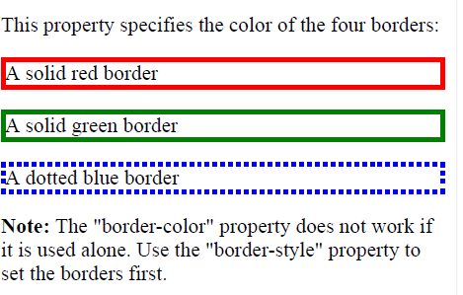

Slide 23
CSS Rounded Borders
<html>
<head>
<style>
p.normal {
border: 2px solid red;
}
p.round1 {
border: 2px solid red;
border-radius: 5px;
}
p.round2 {
border: 2px solid red;
border-radius: 8px;
}
p.round3 {
border: 2px solid red;
border-radius: 12px;
}

Slide 24
</style>
</head>
<body>
<h2>The border-radius Property</h2>
<p>This property is used to add rounded borders to an element:</p>
<p class="normal">Normal border</p>
<p class="round1">Round border</p>
<p class="round2">Rounder border</p>
<p class="round3">Roundest border</p>
</body>
</html>

Slide 25
